Slide 1
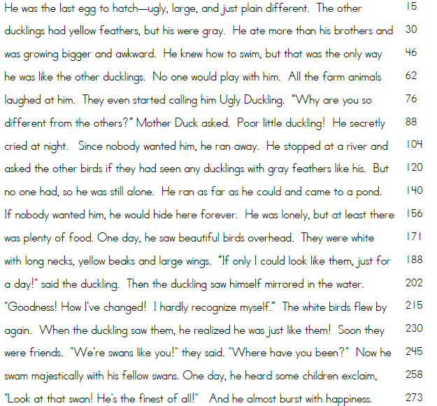
Weekly First Grade Fluency Homework
Directions: (This process should be repeated every night.)
1. Student reads the passage aloud to the parent, who is timing them for EXACTLY one minute. During this time, the parent is also keeping track of any errors the child makes while reading, BUT does NOT try to correct the child at this time.
2. Parent records the number of words read in a minute (use the numbers at the end of each line to help you add quickly) and the number of errors.
3. Parent NOW points out and corrects the errors made to the child.
4. Student should retell everything they remember about the story to the parent.
The Ugly Duckling
 | Day 1 | Day 2 | Day 3 | Day 4
Words read in 1 minute
-number of mistakes
= total words read correctly
Parent initials

